Slide 1

Your Meeting Toolkit

Slide 2

Your Meeting Toolkit
Thank you for your contributions to the success of the AAOS 2025 Annual Meeting! This toolkit includes communications you can use to promote your participation in the conference.
Help us spread the word and pack the room for your presentation!
How to use this toolkit:
Simply copy the text in this toolkit and paste it into your newsletter template, social posts, or email communications. You can also use this toolkit as inspiration for your personalized messages that use your own voice.

Slide 3

Social Media

Slide 4

Connect with AAOS on Social Media
Follow AAOS on social media to help promote the AAOS 2025 Annual Meeting.
Like and share our content to easily promote
the event across your social networks!
Follow us on X (Twitter)
Follow and like us on Facebook
Follow and like us on Instagram
Follow and like us on LinkedIn

Slide 5
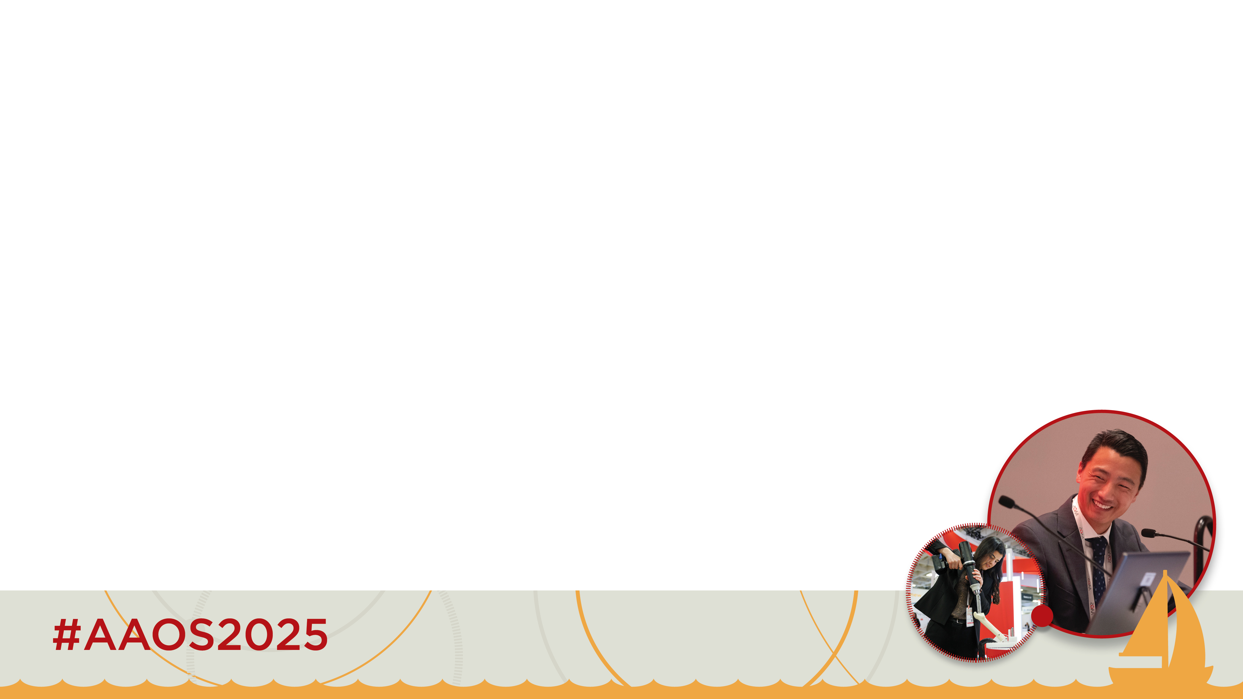
#Hashtagging
Use the hashtag #AAOS2025 on all social media posts featuring AAOS Annual Meeting content.
Why use hashtags?
Hashtags are searchable and our audience can click on hashtags to view a feed with all posts including the hashtag.
See for yourself!
Type “AAOS2025” into the X (Twitter) search bar to see the #AAOS2025 Twitter feed.
Type “AAOS2025” into the LinkedIn search bar to see the #AAOS2025 LinkedIn feed.

Slide 6
Posting on LinkedIn & Facebook
Post 1
[Your Organization’s Name] is looking forward to participating in Specialty Society Programs Day during the AAOS 2025 Annual Meeting on Friday, March 14, in San Diego. Join us for a great day of specialty education in addition to the other powerful content at #AAOS2025. Register now: bit.ly/JoinMe-AAOS2025 #ortho #orthopedicsurgeon #orthopedic
Post 2
Experience the best, global event in orthopaedics: #AAOS2025, taking place March 10–14 in San Diego. When you register, sign up to join us for [Your Organization’s Acronym] Specialty Day on March 14! Learn more and register: bit.ly/JoinMe-AAOS2025 #ortho #orthopedicsurgeon #orthopedic
Personalize and share these posts to spread the word about #AAOS2025 throughout your network!

Slide 7
Posting on X
Post 1
Join us in San Diego, Mar 10–14, to hear about the latest findings in our field and connect with fellow orthopaedic specialists from around the world at #AAOS2025: bit.ly/JoinMe-AAOS2025
#orthotwitter #ortho #orthopaedicsurgeon @AAOS1
Post 2
Experience the best global event in orthopaedics at #AAOS2025! Register today and don’t forget to factor [Your Organization’s Acronym] Specialty Day into your schedule! Learn more: bit.ly/JoinMe-AAOS2025
#orthotwitter #ortho #orthopaedicsurgeon @AAOS1
Post 3
Convene with the global orthopaedic community for a meeting dedicated to innovation, education, and collaboration. Our specialty session happens Mar. 14! Learn more about #AAOS2025 and sign up today: bit.ly/JoinMe-AAOS2025
#orthotwitter #ortho @AAOS1
Personalize and share these posts to spread the word about #AAOS2025 throughout your network!

Slide 8

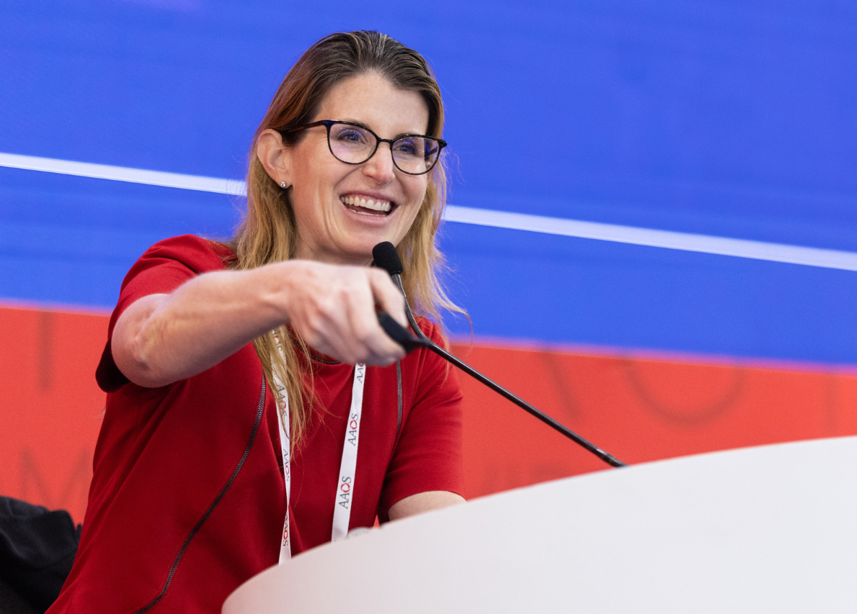
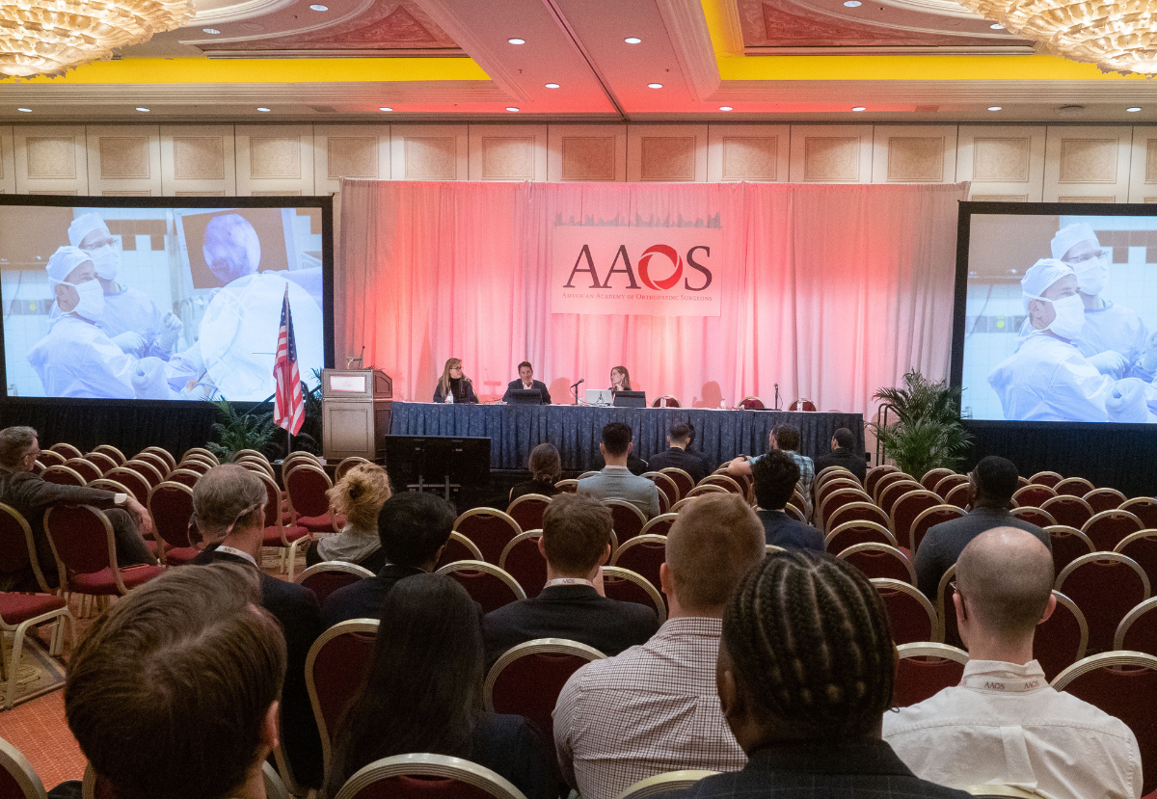
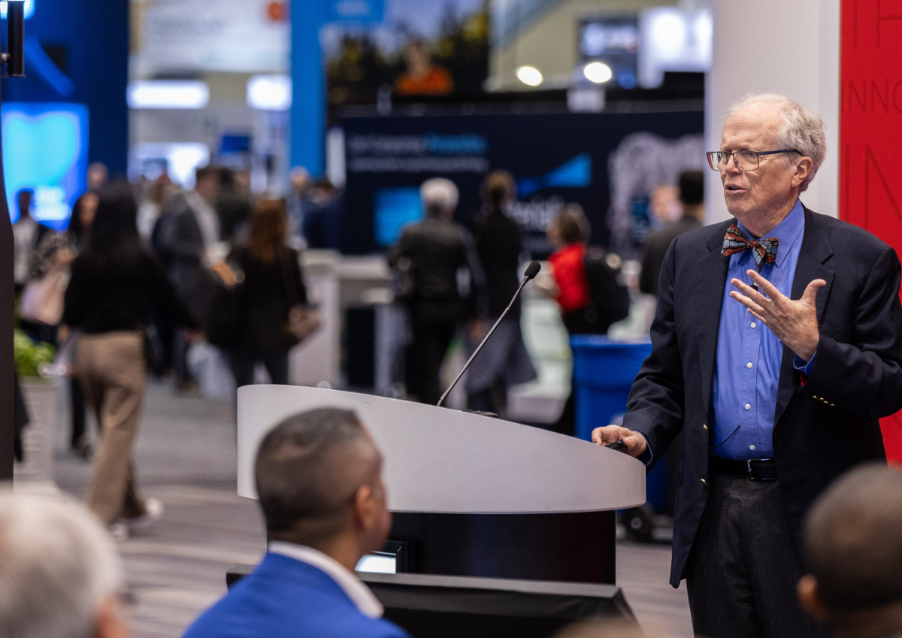
Use These Graphics on Social!
Create your own posts about what you're most excited about at this year's event using the hashtag #AAOS2025 and add your own image or borrow one of ours in the following slides.

Slide 9


Shareable Image
Facebook, LinkedIn, and X
Right-click the picture you’d like to use and select ‘Save as Picture’ or ‘Copy’ to save one of these images to your files and upload with your posts.

Slide 10






Shareable Images
Instagram
Right-click the picture you’d like to use and select ‘Save as Picture’ or ‘Copy’ to save one of these images to your files and upload with your posts.

Slide 11
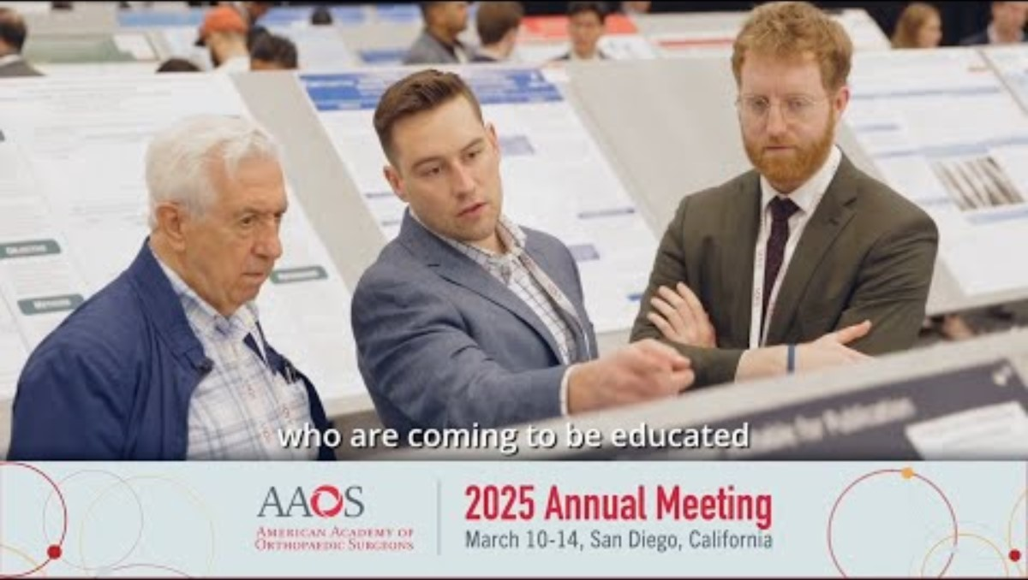
YouTube Videos
Share on Facebook, Twitter, or LinkedIn
AAOS 2025 YouTube Playlist

Slide 12
Email

Slide 13
Personalized Email
Did you know?
92% of people trust recommendations from friends over any other type of advertising.
People are most likely to decide if they will attend the AAOS 2025 meeting between September 2025 and December 2025.
The top 4 reasons why ortho professionals register for the Annual Meeting are education, content quality, CMEs, and networking opportunities.
Personalize the email on the next slide then send it to your network to help spread the word about the AAOS 2025 Annual Meeting.
Be sure to include the hyperlinks so your contacts can view the program and register directly from your message.

Slide 14
Suggested subject line: Let's Connect at #AAOS2025 in San Diego!
[Your Colleague’s Name Here],
I’m reaching out to personally invite you to attend the AAOS 2025 Annual Meeting on March 10-14 in San Diego. This year, Specialty Day is March 14! Our [Meeting Name] takes place [Your Organization's Time]. I hope to see you there!
AAOS is back and better than ever in 2025 with a refined program, excellent education, and powerful discussions. It's the only place where I can connect with a global network of orthopaedic surgeons and get the training I need to help impact my patient's care.
If you haven’t had a chance to do so yet, I encourage you to visit bit.ly/JoinMe-AAOS2025 and find out more about opportunities to learn, innovate, and collaborate with colleagues in San Diego. I highly encourage you to browse the education program online to find the right learning opportunities for you.
Feel free to reach out to me with any questions. I hope to see you soon in San Diego!
Sincerely,
[Your Name Here!]
Email​ Template
Feel free to add your own experiences and customize this message.

Slide 15

Email Signature Line
How many emails do you send and receive a day?
Take advantage of your constant communication by sharing your support of the meeting and encouraging everyone in your professional network to attend! Choose from one of the options below or feel free to change things up where you see fit.
I’ll be at the AAOS 2025 Annual Meeting. Will I see you there? Register today and join me in San Diego, March 10–14!
Join leaders and innovators from around the world at the AAOS 2025 Annual Meeting to experience world-class education and build lifelong connections. Learn more & register!
AAOS 2025 Email Signature Banner

Slide 16
Newsletters

Slide 17
Personalized Email
Post 1
The AAOS 2025 Annual Meeting convenes the global musculoskeletal health community for a meeting dedicated to innovation, education, and collaboration. Attendees at all stages of their career will exchange insights, learn the latest practice techniques, experience state-of-the-art exhibits, and collaborate with a diverse audience of healthcare and industry professionals in orthopaedics. Explore the program and register today!
Post 2
The AAOS 2025 Annual Meeting returns March 10-14 in San Diego and is better than ever! Be part of the most influential, global forum for orthopaedic surgery March 10–14, 2025.
Register today for the opportunity to experience groundbreaking innovation, cutting-edge research, powerful collaboration and impactful education.
Does your organization send a newsletter or have a virtual message board?
Use this suggested content to promote the meeting in these important locations.

