Slide 1
COVID-19 Response Update
April 23, 2020

Slide 2
Agenda
Restarting Elective Surgery
Advocacy
Coding
Q & A
AAOS Video
Send questions to COVID19@aaos.org or via the webinar platform question box

Slide 3
AAOS Guidelines on Return to Surgery
Concerns
Patient safety
Risks and benefits
Second wave of infections: what is the risk?
Testing accuracy type and necessity

Slide 4
Considerations
Has your area seen a sustained reduction (i.e. ≥ 14 days) in new cases of COVID-19?
Are all patients in your area with COVID-19 symptoms able to access testing?
Is your state able to conduct active monitoring of confirmed or suspected cases and their contacts?
Are you able to verify if your patients have undergone testing?
Should different criteria apply to patients with higher risk of severe consequences from a COVID-19 infection?
Specifically those 65+ or with significant co-morbidities

Slide 5
AAOS Guidelines
Priority #1
The safety of patients is highest priority when considering the provision of health care services, items and procedures during the COVID-19 pandemic.
Priority #2
The safety of health care personnel and staff should be next highest priority, after accounting for patient safety, when considering the provision of health care services, items and procedures.
Screening of patients and health care workers is essential
Testing should be utilized as much as availability allows
Go to the AAOS COVID-19 Resource Center – Guidance for Elective Surgery

Slide 6
CMS Guidelines
Adequate facilities, workforce, testing, and supplies are available to handle resumption of surgery
Adequate workforce across phases of care (e.g. availability of clinicians, nurses, anesthesia, pharmacy, imaging, pathology support and post-acute care
Screening all patients and health care workers, testing when available
Go to the AAOS COVID-19 Resource Center – Guidance for Elective Surgery

Slide 7
What are the risks ?
What are the risks of doing surgery on COVID-19+ patients?
Does elective surgery increase risk of getting COVID-19?
What are the risks of surgery in patients with comorbidity?

Slide 8
Clinical characteristics and outcomes of patients undergoing surgeries during the incubation period of COVID-19 infection
Thirty-four operative patients, median age = 55 years (IQR, 43–63), 20 (58·8%) patients were women.
All patients developed COVID-19 pneumonia shortly after surgery with abnormal findings on chest computed tomographic scans.
Common symptoms included fever (31 [91·2%]), fatigue (25 [73·5%]) and dry cough (18 [52·9%]).
Fifteen (44·1%) patients required admission to ICU during disease progression, 7 patients (20·5%) died after admission to ICU
DOI: https://doi.org/10.1016/j.eclinm.2020.100331
Shaoquing Lei et. al Lancet 4/4/20

Slide 9
Risk of getting COVID-19 after elective surgery
Lancet: 79% COVID-19 negative patients developed COVID-19 within two weeks after elective surgery

Slide 10
Treatment of proximal femoral fragility fractures in patients with COVID-19 during the SARS-CoV-2 outbreak in Northern Italy
Three patients died before surgery due to severe respiratory insufficiency and multiple-organ-failure syndrome.
Ten patients underwent surgery on day after admission, whereas 3 patients had suspended their use of direct thrombin inhibitors and needed surgery to be delayed until the third day after admission.
In all patients except one, noted an improvement in terms of O2saturation and assisted respiration.
In 9 patients, hemodynamic and respiratory stability was observed at an average of 7 days postoperatively.
Four patients who underwent surgical treatment died of respiratory failure on the first day after surgery (1 patient), the third day after surgery (2 patients), or the seventh day after surgery (1 patient).
doi: 10.2106/JBJS.20.00617 - 11 of 16 patients died
Francesco Catellani, MD1, Andrea Coscione, MD1, Riccardo D’Ambrosi, MD2, Luca Usai, MD1, Claudio Roscitano, MD1, and Gennaro Fiorentino, MD1 JBJS Express

Slide 11
Meaning of Data?
Not much available
Worst case, if you don’t test:
1 in 5 patients will have COVID-19
20% of the “1’s” will have a fatality
So, 4% of your patients will die from surgery
Is that real?
Doubt it, but we don’t really know - numbers are very small and probably do not apply to the US but it's all we have

Slide 12
Rights of Employed Physicians
What if you are employed and don’t really have control to deal with this issue?
Physicians’ rights during the current Public Health Emergency (PHE)
Stark law flexibilities related to suspension of elective surgeries
Employers (such as, hospitals ad health systems) have added flexibilities during the PHE
Advocate for patient rights and patient safety
No employer should impede physicians’ freedom to advocate for the best interest of patients
Reference:
Zarefsky, M. (2020, April 21). Amid COVID-19 upheaval, know your rights as an employed physician. AMA. Available: https://www.ama-assn.org/practice-management/sustainability/amid-covid-19-upheaval-know-your-rights-employed-physician
Notes:
Given the current Stark law flexibilities, the AMA suggests that physicians have greater leverage in negotiating compensation packages.
Among other things, this means that:
A physician can negotiate a higher payment rate per hour for work performed outside of normal duties in order to address COVID-19 patient care needs in the form of hazard pay.
A hospital can agree to guarantee a certain level of financial compensation for physicians who are paid based on their productivity, but whose production has decreased due to the inability to perform elective surgeries.
A physician and employer can mutually agree to a one-time severance agreement that pays the physician a defined amount of compensation in case of termination.
Employer flexibilities
As the COVID-19 pandemic continues, hospitals and health systems will have an added amount of flexibility in the agreements they are able to make with physicians who negotiate as part of the termination process.
For example, physicians whose positions are terminated can try and negotiate for:
Severance packages.
Waivers of noncompete clauses that would allow the physician to continue practicing in the immediate vicinity of the employer.
Access to the employer’s electronic health record or other technology and resources at a free or reduced rate for the duration of the COVID-19 pandemic.
Patient rights
Patients’ welfare should be the first priority in any situation where the interests of physicians and hospitals are in conflict. No employer should restrict physicians’ freedom to advocate for the best interest of their patients.”
The AMA guide includes additional examples of employment-related concessions that terminated employees can seek from their employer.

Slide 13
Current AAOS Thoughts
Look at AAOS guidelines; will be regularly updated
Hot spot: start with healthy patients, under 65, no comorbidities, and do the surgery as outpatient to minimize risk
Test if possible; everyone on day of surgery, as much as possible 1-7 days before surgery as well, if available
Screen all patients and health care workers, but keep in mind you will miss 20% of infected patients with screening only
When reliable antibody tests are available -- test as much as possible

Slide 14
Advocacy

Slide 15
Financial Support for Private Practices
Current Wins | Current Asks
Small Business loan programs and Mainstreet Lending Programs apply to private practices Congress suspended 2% cuts to Medicare expected through sequestration CMS Accelerated and Advance Payment Program $30 billion Initial CMS Funding | Relief for rural practices Refinements to CMS Accelerated and Advance Payment Program E/M code adjustments to global surgical bundles
Notes:
We wrote letters and had conversations with members of Congress and their staff about several items relating to financial relief for physician practices:
SEQUESTRATION
The Coronavirus Aid, Relief, and Economic Security (CARES) Act temporarily suspends the -2% sequestration payment adjustment on Medicare fee-for-service payment. This means that physicians will see a 2% payment increase on Medicare claims effective May 1, 2020. The increase is effective for claims with dates of service from May 1, 2020, through December 31, 2020.
ACCELERATED AND ADVANCE PAYMENTS PROGRAM
In order to increase cash flow to providers of services and suppliers impacted by COVID-19, the Centers for Medicare & Medicaid Services (CMS) has expanded our current Accelerated and Advance Payment Program to a broader group of Medicare Part A providers and Part B suppliers. The expansion of this program is only for the duration of the public health emergency. Most providers and suppliers will be able to request up to 100% of the Medicare payment amount for a three-month period.
$30 BILLION IN CMS FUNDING
This is part of the CARES Act. Beginning Apr 10, 2020, HHS is partnering with UnitedHealth Group (UHG) to deliver the initial $30 billion distribution to providers as quickly as possible. Providers will be paid via Automated Clearing House account information on file with UHG, UnitedHealthcare, or Optum Bank, or used for reimbursements from the Centers for Medicare & Medicaid Services (CMS). Providers who normally receive a paper check for reimbursement from CMS will receive a paper check in the mail for this payment as well, within the next few weeks. Facilities and providers are allotted a portion of the $30 billion based on their share of 2019 Medicare fee-for-service (FFS) reimbursements. These are payments, not loans, to healthcare providers, and will not need to be repaid.
REFINEMENTS TO MEDICARE ADVANCED PAYMENT PROGRAM
We are working on the following changes: a decrease in the interest rate (currently at 10.25%), extending both the application deadline and finally extending the repayment deadline. We are also asking for loan forgiveness for rural practices who demonstrate financial need
E/M CODE ADJUSTMENT
The Centers for Medicare and Medicaid Services’ (CMS) final Medicare Physician Fee Schedule (MPFS) rule for CY 2020 included broad changes to reduce administrative burden, improve payment rates, and reflect current clinical practice, especially as it relates to evaluation and management services (E/M). Unfortunately, CMS proposed not to apply the payment adjustment to the E/M portion of the global codes. Arbitrarily adjusting some E/Ms but not others is in conflict with current law. The financial impact of the COVID-19 pandemic has been swift and is already being felt across every sector of the healthcare provider community. Therefore, AAOS has asked Congress to waive the budget neutrality requirements stipulated in Section 1848(c)(2) of the Social Security Act for the finalized E/M code proposal for a period of no less than five years.

Slide 16
HIPAA and Telemedicine
Current Wins | Current Asks
HIPAA flexibility for good faith actions to provide telehealth Temporary expansion of telemedicine services CMS Accelerated and Advance Payment Program | Update and clarify telehealth flexibilities Uniform telehealth flexibilities for Medicare, Medicaid and commercial insurance to ease burden
Notes:
HIPAA FLEXIBILITY
Beginning Mar 17, 2020 and through the entire period of the Public Health Emergency, the Office for Civil Rights (OCR) at the U.S Department of Health and Human Services (HHS) announced that it will waive potential penalties for HIPAA violations against health care providers that serve patients through everyday communications technologies during the COVID-19 nationwide public health emergency. FAQ: https://www.hhs.gov/sites/default/files/telehealth-faqs-508.pdf
DELAY IN COMPLIACE FLEXIBILITIES
On April 21, 2020, the Office of the National Coordinator for Health IT (ONC) and the Centers for Medicare & Medicaid Services (CMS), in conjunction with the HHS Office of Inspector General (OIG) announced a policy of enforcement discretion to allow compliance flexibilities regarding the implementation of the interoperability final rules announced on March 9th in response to the coronavirus disease (COVID-19) public health emergency. ONC, CMS, and OIG will continue to monitor the implementation landscape to determine if further action is needed. This delay was allowed in response to providers asking that interoperability benchmarks were impossible to meet amid a surge of coronavirus cases and other related crises.
CLARIFIYING CODES
We are asking for reimbursement for telehealth at the same rate as face to face care for new patients, for audio only check ins to be counted as telehealth services, and for flexibility for utilization of non-physician clinical staff in facilities to lower in person contact (e.g. allowing nurses or physician assistants to help with audio or video in communicating with patients in hospitals or nursing homes).
UNIFORM TELEHEALTH FLEXIBILITIES
We are asking for commercial insurance companies to align with Medicare in allowing telehealth flexibilities in terms of coding requirements, modes used and dates for allowing such flexibilities to lessen physician burden.

Slide 17
Physician Safety and Benefits
Current Wins | Current Asks
Guidance to protect surgeons and clinical staff during emergent surgeries for infected or possibly infected patients | Ensure physicians are covered under the paid sick leave provisions instituted by the Families First Coronavirus Response Act Streamlined distribution for PPE and essential medical equipment
Notes:
PROTECTING SURGICAL TEAMS
In March Dr Weber wrote a letter to VP Pence asking for CDC guidance on protecting surgical teams and streamlined guidance for distribution of PPE and essential medical equipment. In response on April 13, CDC issued new infection control guidelines for clinicians. Available here: https://www.cdc.gov/coronavirus/2019-ncov/hcp/infection-control-recommendations.html
PAID FAMILY MEDICAL LEAVE/SICK LEAVE
Congress should take action to ensure physicians, healthcare workers, and first responders are included and covered under the paid sick leave provisions instituted by the Families First Coronavirus Response Act.
Protecting hospitals’ bottom lines at the very expense of the people they employ is not acceptable – the same safety net coverage that has been extended to the rest of Americans should be extended to those serving on the frontlines.

Slide 18
Physician Owned Hospitals & ASCs
Current Wins
CMS issued waivers to allow POHs to expand during COVID-19 crisis CMS’ hospitals without walls: transfer patients to ASCs, hotels, etc. and still get paid at hospital rates CMS Accelerated and Advance Payment Program Additional Stark flexibilities
Notes:
PHYSICIAN OWNED HOSPITALS:
During the COVID-19 emergency, physician-owned hospitals can temporarily increase the number of their licensed beds, operating rooms, and procedure rooms, even though such expansion would otherwise be prohibited under the Stark Law. For example, a physician-owned hospital may temporarily convert observation beds to inpatient beds to accommodate patient surge during the COVID-19 pandemic in the United States.
Many POHs partner with other health care providers or entities that specialize in administrative duties necessary to run a small business. Even though these POHs are independently owned and operated, the SBA’s current affiliation rules may link what are otherwise unrelated POHs together through common ownership, even minority ownership (e.g. 25 percent) / equity only investment at 51%, or by a management agreement with the same management company and therefore exclude them from relief under the Paycheck Protection Program. It is critical to exempt health care providers such as POHs that are enrolled in Medicare from affiliation rules during the covered period of the COVID crisis.
Additionally, AAOS would like to see this expansion made permanent, as well as allowance for new construction of POHs.
INCREASE HOSPITAL CAPACITY - CMS HOSPITALS WITHOUT WALLS
CMS is allowing healthcare systems and hospitals to provide services in locations beyond their existing walls to help address the urgent need to expand care capacity and to develop sites dedicated to COVID-19 treatment. Under CMS’s temporary new rules, hospitals will be able to transfer patients to outside facilities, such as ambulatory surgery centers, inpatient rehabilitation hospitals, hotels, and dormitories, while still receiving hospital payments under Medicare.
STARK LAWS
On March 30, 2020, HHS issued blanket waivers to permit certain financial relationships and referrals that would otherwise be non compliant with the Physician Self-Referral Law (Stark Law). These blanket waivers were given a retroactive effective date of March 1, 2020. Similar to other Section 1135 waivers issued in response to the COVID-19 public health emergency. These include the ability to pay physicians hazard pay and provide personal protective equipment at below fair market value if related to COVID-19.

Slide 19
Relief for Physicians in Medicare Quality Payment Program
Current Wins | Current Asks
Delayed 2019 MIPS reporting deadline MIPS Improvement Activity credit for participating in COVID-19 clinical trials | Loan forgiveness and downside risk stoppage in BPCI Advanced and other CMMI model participants Extend Automatic Extreme and Uncontrollable Circumstances Policy for all QPP participants for CY 2020 Delay MIPS Value Pathways (MVP)
Notes:
2019 MIPS reporting deadline has been extended to April 30 and those who fail to report by that date will get an no penalty.
Clinicians may now earn credit in the Merit-based Incentive Payment System (MIPS), for participation in a clinical trial and reporting clinical information by attesting to the new COVID-19 Clinical Trials improvement activity. This action will provide vital data to help drive improvement in patient care and develop innovative best practices to manage the spread of COVID-19 within communities.

Slide 20
Liability Protections
Current Wins | Current Asks
Good Samaritan flexibilities | Blanket liability protections for physicians who are working outside their normal practice area in order to provide surge capacity, but not volunteering
Notes:
MEDICAL LIABILITY
AAOS supports blanket liability protections for physicians who are working outside their normal practice area in order to provide surge capacity but not volunteering and therefore not covered by the “good Samaritan” language in CARES.
As physicians risk their lives to treat those in COVID-19 “hot spots”, whether it’s through contractual support or through volunteering, they should be provided a uniform level of protection and avoid the situation whereby a patchwork of liability laws across the country would lead to unequal treatment of our frontline healthcare providers and facilities during this national crisis.
Health care professionals and facilities are making every effort to provide the best care possible to an increasingly larger patient population, work with limited tools/PPE, and practice under circumstances which are forcing them to shift limited resources to address urgent needs.
The following situations, none of which are the result of wrongdoing by caregivers or the facilities in which they operate, pose substantial liability risks:
To meet increasing demand, physicians are being asked to provide treatments or care outside their general practice areas and for which they may not have the most up-to-date knowledge;
Physicians who have left the practice of medicine are being asked to come out of retirement to address the shortage of healthcare providers;
Healthcare professionals, and the facilities in which they practice, often have inadequate safety equipment that could result in the transmission of the virus from patient to provider and then to additional patients, or directly from one patient to another;
Facilities are facing shortages of equipment, such as ventilators, and being forced to ration care;
Inadequate testing could lead to delayed or flawed diagnosis;
“Elective” surgeries and procedures are being delayed to preserve capacity for those with the coronavirus; and
Patients with issues other than coronavirus are facing delayed treatments so that resources may be saved for coronavirus patients.

Slide 21
Small Business Loans
Economic Injury Disaster Loan Program​
Maximum amount of $2,000,000 with 3.7% interest rate​
Loan term of up to 30 years​
First payment not due for a full year​
Paycheck Protection Program
Designed to help maintain payroll
Maximum amount of $10,000,000
Loan forgiven if business maintains payroll
Need more money (got it)
Notes:
Economic Injury Disaster Loan Program
Week of 4/20 there was an increase to the Emergency Economic Injury Disaster (EIDL) grants from $10B to $20B (an increase of $10B); increases the EIDL loan program by $50B
Must be adversely impacted by the Covid-19 pandemic
Small business with 500 or fewer employees, or businesses in certain industries if they meet the SBAs size standards
Maximum amount of $2,000,000.
Interest rate of 3.7%
Loan term of up to 30 years, depending on the needs of the borrower
Proceeds must be used for working capital needs such as fixed debt and payroll
Loan advance of up to $10,000 will not have to be repaid
Paycheck Protection Program
Initial money was depleted on April 16th, funding re-upped week of 4/20 by an increase of $321B
$60 B set aside for institutions with assets under $50B
$30B is for those institutions between $10-$50B in assets
$30B is for those institutions with less than $10B in assets
These will be made by depository institutions such as community banks, CDFI’s, etc
Intended to incentivize businesses to keep their employees on payroll during the pandemic
Administered through third party lenders
Loans will be forgiven if employers maintain payroll
Loan amount will equal 250% of average monthly payroll
Debt forgiveness is from Feb 15-June 30th
Allows you to use the loan to cover payroll costs, including salaries, paid sick and medical leave, insurance premiums, mortgage, rent and utility payments.

Slide 22
Economic Stabilization Fund
(up to 10,000 employees)
Main Street Lending Program
Provides up to $600 billion in loans to eligible borrowers
Intended for businesses of up to 10,000 employees
Repayment in 4 years
Notes:
Main Street Lending Program
Two programs: the Main Street New Loan Facility (MSNLF) and Main Street Expanded Loan Facility (MSELF). Cannot participate in both programs
Loans require attestations stating that eligible borrowers require the loans as a result of circumstances precipitated by Covid-19 pandemic and that the funds will be used to make efforts to maintain payroll and retain employees
For businesses with less than 10,000 employees or less than $2.5 billion in 2019 annual revenue
4-year maturity
Pre-payment permitted without penalty
MSNLF loans between $1 million and the lesser of $25 million OR an amount that, when added to the eligible borrower’s existing outstanding debt does not exceed four times the eligible borrower’s 2019 earnings before interest, taxes, depreciation, and amortization.
MSELF loans between $1 million and the lesser of $150 million 30% of the eligible borrower’s existing outstanding debt, OR an amount that, when added to the eligible borrower’s existing outstanding debt does not exceed six times the eligible borrower’s 2019 earnings before interest, taxes, depreciation, and amortization.

Slide 23
HHS Funding
Public Health and Social Services Emergency Fund—Provider Relief Fund
$30 billion to healthcare providers
A grant, does not need to be paid back
Funds were distributed beginning April 11, 2020
Based on individual versus total 2019 Medicare FFS payments
The care provided does not need to be specific to COVID-19, and HHS is emphasizing that every patient may be considered a possible case of COVID-19.
Notes:
On 4/22, HHS announced an extra $70B will be released from the CARES relief fund:
Allocations of CARES Act Provider Relief Fund ($100 billion)
$20 billion will go to providers with a relatively small share of their revenue coming from Medicare fee-for-service, such as children’s hospitals
Payments will go out weekly, on a rolling basis, as information is validated starting on April 24, 2020
$10 billion allocation for covid-19 high impact areas, a targeted distribution to hospitals in areas that have been particularly impacted by the COVID-19 outbreak such as hospitals serving COVID-19 patients in New York.
Allocation for the uninsured
Health care providers who provided treatment for uninsured COVID-19 patients on or after February 4, 2020, can request claims reimbursement and will be reimbursed at Medicare rates, subject to available funding through HRSA
$10 bn allocation for rural providers on the basis of operating expenses, using a methodology that distributes payments proportionately to each facility and clinic.
$400 million for Indian Health Service distributed on the basis of operating expenses in addition to support for telehealth infrastructure
Providers can register for the program on April 27, 2020, and begin submitting claims in early May 2020. For more information, visit hrsa.gov/coviduninsuredclaim
Some providers, including skilled nursing facilities, dentists, and providers that solely take Medicaid will receive further, separate funding
Payments are based on an HHS-determined methodology, which can be estimated by providers as their individual 2019 Medicare FFS payments divided by total 2019 FFS payments ($484,000,000,000) and multiplied by $30,000,000,000.
Within 30 days of receipt of the funds, providers are required to sign an attestation confirming receipt and agreeing to the terms and conditions.
If there is evidence of grave misuse or illegal use of the funds, or if the provider balance bills for COVID-19 related treatment, HHS has the authority to require repayment of the grant.
All facilities and providers that received Medicare Fee-for-Service (FFS) reimbursement in 2019 will be eligible for these funds.
providers will still be eligible to receive the funds if they provide diagnoses, testing, or care for individuals with possible or confirmed cases of COVID-19.
Week of 4/20 increase of $75 billion

Slide 24
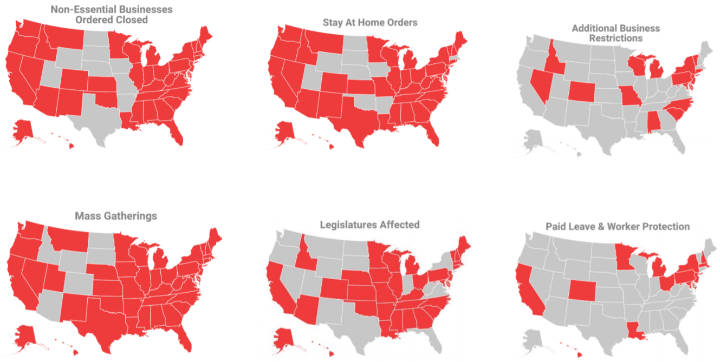
COVID-19 State Actions
Notes:
More than 120 bills have been introduced in 40 states, Puerto Rico, and the District of Columbia on paid sick leave and worker protections, as well as appropriations requests.
Over 295 executive actions have been issued related to declarations of states of emergency, school closures, prohibition of mass gatherings, retail and business closures and restrictions and stay-at-home orders. Over 960 executive actions have been issued in total.
More than 20 state task forces have been established by 12 governors.
More than 25 states and the District of Columbia have issued emergency regulations on a variety of issues including, but not limited to insurance carriers, labor & wage issues and medical licensure.
71 legislative chambers have either temporarily adjourned, moved to virtual meetings, or announced an early recess or adjourned for the year.

Slide 25
State Issues Impacting Physicians and Patients
Access and costs associated with testing & treatment
Licensure portability
Medicaid flexibilities (Section 1135 waivers)
Liability issues/Good Samaritan protections
Telemedicine advancements
Elective procedure restrictions
Prior authorization burdens
Credentialing
PPE supply chain
Notes:
States have been grappling with a variety of issues in responding to the COVID-19 pandemic, including, but certainly not limited to, these important challenges impacting physicians and our patients:
Patient cost-sharing and access to testing and treatment, especially among those lacking insurance or having recently lost employer-sponsored coverage.
Allowing physicians licensed in good standing to practice across state lines.
This is an important element, though it’s vital that if states include broad language to include reciprocity for all health care professionals, that they also include language clarifying that they are subject to the scope-of-practice laws of the host state and may not exceed the scope established by their state.
It’s also vitally important that medical liability issues during the pandemic are addressed. Specifically, states should:
Provide immunity from civil liability for any harm caused in the course of providing medical services in support of the state’s response to the COVID-19 outbreak, harm caused by volunteer physicians acting in good faith and harm caused resulting from a federal, state or local directive to cancel, delay or deny care as a result of the COVID-19 pandemic.
Eliminating barriers to providing care by telemedicine and advocating for appropriate reimbursement is also paramount.
And as we all know, states have established a variety of restrictions on procedures considered “elective.”

Slide 26
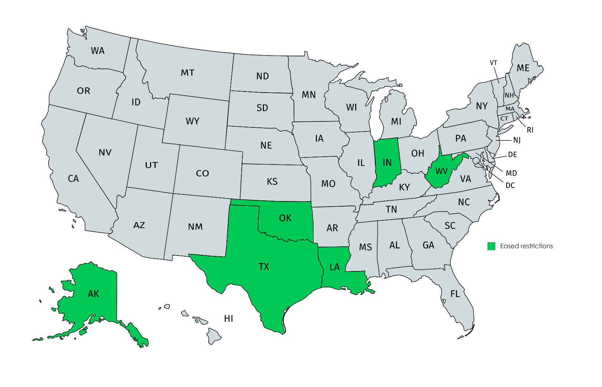
States Begin to Ease Elective Procedure Restrictions
Alaska
Indiana
Louisiana
Oklahoma
Texas
West Virginia
*Updated as of April 21
Notes:
We are beginning to see some states ease restrictions that have been placed on elective procedures.
States vary significantly concerning how to distinguish between services that should be delayed and those that should not.
Regardless of the specifics that states provide, physicians should consult the recommendations from CMS, the CDC, AAOS and the American College of Surgeons to aid in decision-making.
Background:
AK: Gov. Dunleavy issued a mandate to allow non-urgent elective services, that cannot be delayed beyond eight weeks without posing a significant risk to quality of life, to resume May 4. The order additionally lays out a range of safety precautions that must be met in order for facilities, which explicitly include ambulatory surgical centers, to provide elective services.
IN: Gov. Holcomb announced the easing of elective surgery restrictions on hospitals this week. He added “… if state medical supplies remain adequate, then more procedures at clinics and surgery centers could be allowed next week.”
LA: Gov. John Bel Edwards indicated providers could restart some “time sensitive” non-emergency procedures on April 27.
OK: Gov. Stitt issued an amendment to previous executive orders setting guidelines for medical providers to determine which elective surgeries may resume April 24.
Additionally, Gov. Stitt signed an executive order outlining an Elective Surgery Acuity Scale (ESAS) for medical providers to follow regarding when elective surgeries can be performed during the COVID-19 state of emergency.
TX: Last Friday, Gov. Abbott, by executive order, loosened restrictions on surgeries put in place in March:
The order states that beginning April 21 through May 8, all health care professionals and all health care facilities must continue to postpone all surgeries and procedures that are not medically necessary to diagnose or correct a serious medical condition of, or to preserve the life of, a patient who without timely performance of the surgery or procedure would be at risk for serious adverse medical consequences or death as determined by a patient's physician. Exceptions now include:
Any procedure that, if performed in accordance with the commonly accepted standard of clinical practice, would not deplete the hospital capacity or the PPE needed to cope with COVID-19, or
Any surgery or procedure performed in a licensed health care facility that has certified in writing to Texas HHSC both (1) that it will reserve at least 25% of its hospital capacity for treatment of COVID-19 patients, accounting for the range of clinical severity of COVID-19 patients, and (2) that it will not request any PPE from any public source — whether federal, state, or local — for the duration of the COVID-19 disaster.
WV: Gov. Justice issued an executive order outlining the process for hospitals to apply to resume elective medical procedures, provided that certain safety thresholds are met. The earliest hospitals will be able to restart elective medical procedures is April 28.

Slide 27
Our Orthopaedic PAC
2019 Success:
Best off-election year in our history
Raised a record-breaking $1.9 million
2020 Update:
Continuing to facilitate political events and meetings with legislators
Our PAC is a critical tool to ensure that we have a seat at the table for policy discussions
Facilitate in district meetings during August recess
Join Today:
Text ‘AAOS’ to 41444 and follow the prompts
It’s that easy!
Notes:
Access is especially important during COVID crisis.
2020 is an important election year and we need to make sure our war chest is fully funded to support physician and ortho friendly candidates and members of Congress.

Slide 28
CARES 3.5
HHS Funds
$75 Billion for reimbursement to hospitals and healthcare providers
$25 Billion for testing
$6 Million for oversight
Requires localized plans on how resources will be used
Paycheck Protection Program (PPP)
Increased funds by $310 Billion
Economic Injury Disaster Loan
Increased funds by $10 Billion
Notes:
$75 billion for reimbursement to hospitals and healthcare providers to support the need for COVID-19 related expenses and lost revenue. Language remains the same as CARES Act. This funding is in addition to the $100 billion provided in the CARES Act.
$25 billion for necessary expenses to research, develop, validate, manufacture, purchase, administer, and expand capacity for COVID-19 tests. Specific funding is provided for:
$11 billion for states, localities, territories, and tribes to develop, purchase, administer, process, and analyze COVID-19 tests, scale-up laboratory capacity, trace contacts, and support employer testing. Funds are also made available to employers for testing.
$2 billion provided to States consistent with the Public Health Emergency Preparedness grant formula, ensuring every state receives funding;
$4.25 billion provided to areas based on relative number of COVID-19 cases;
$750 million provided to tribes, tribal organizations, and urban Indian health organizations in coordination with Indian Health Service.
$1 billion provided to Centers for Disease Control and Prevention for surveillance, epidemiology, laboratory capacity expansion, contact tracing, public health data surveillance and analytics infrastructure modernization.
$1.8 billion provided to the National Institutes of Health to develop, validate, improve, and implement testing and associated technologies; to accelerate research, development, and implementation of point-of-care and other rapid testing; and for partnerships with governmental and non-governmental entities to research, develop, and implement the activities.
$1 billion for the Biomedical Advanced Research and Development Authority for advanced research, development, manufacturing, production, and purchase of diagnostic, serologic, or other COVID-19 tests or related supplies.
$22 million for the Food and Drug Administration to support activities associated with diagnostic, serological, antigen, and other tests, and related administrative activities;
$825 million for Community Health Centers and rural health clinics;
Up to $1 billion may be used to cover costs of testing for the uninsured.

Slide 29
CARES 4.0
Expected to begin debate in early May, but could not wrap up until June
Support for local economies
Further liability protections
Including 501 c(6) in PPP
Adjustments to Medicare Advanced Payments
Potential for proxy voting in the House
Notes:
Support for local economies
infrastructure specific funding
additional support for unemployed works and distressed industries (think hospitality, retail, healthcare),
more funding for the education sector
Liability Protections
Could cover protections
Including 501 c(6) in PPP
Currently
Adjustments to Medicare Advanced Payment
We’re hearing that the interest rate may be lowered and the payment date extended
Loan forgiveness for practices who show financial hardship

Slide 30
Advocacy Beyond COVID-19
Opportunity for POH waiver to become permanent
Much discussion and excitement surrounding expansion of telemedicine
Stark flexibilities
Quality program flexibilities
Notes:
We believe that there is opportunity to use the flexibilities we’ve found during covid from both Congress and the administration to push many of our priorities moving forward.
There is:
Opportunity for the POH waiver to become permanent
Much discussion and excitement surrounding expansion of telemedicine
Opportunity for the current stark flexibilities to become permanent
The current flexibilities in the quality program flexibilities to be expanded and potentially permanent

Slide 31
aaos.org

Slide 33
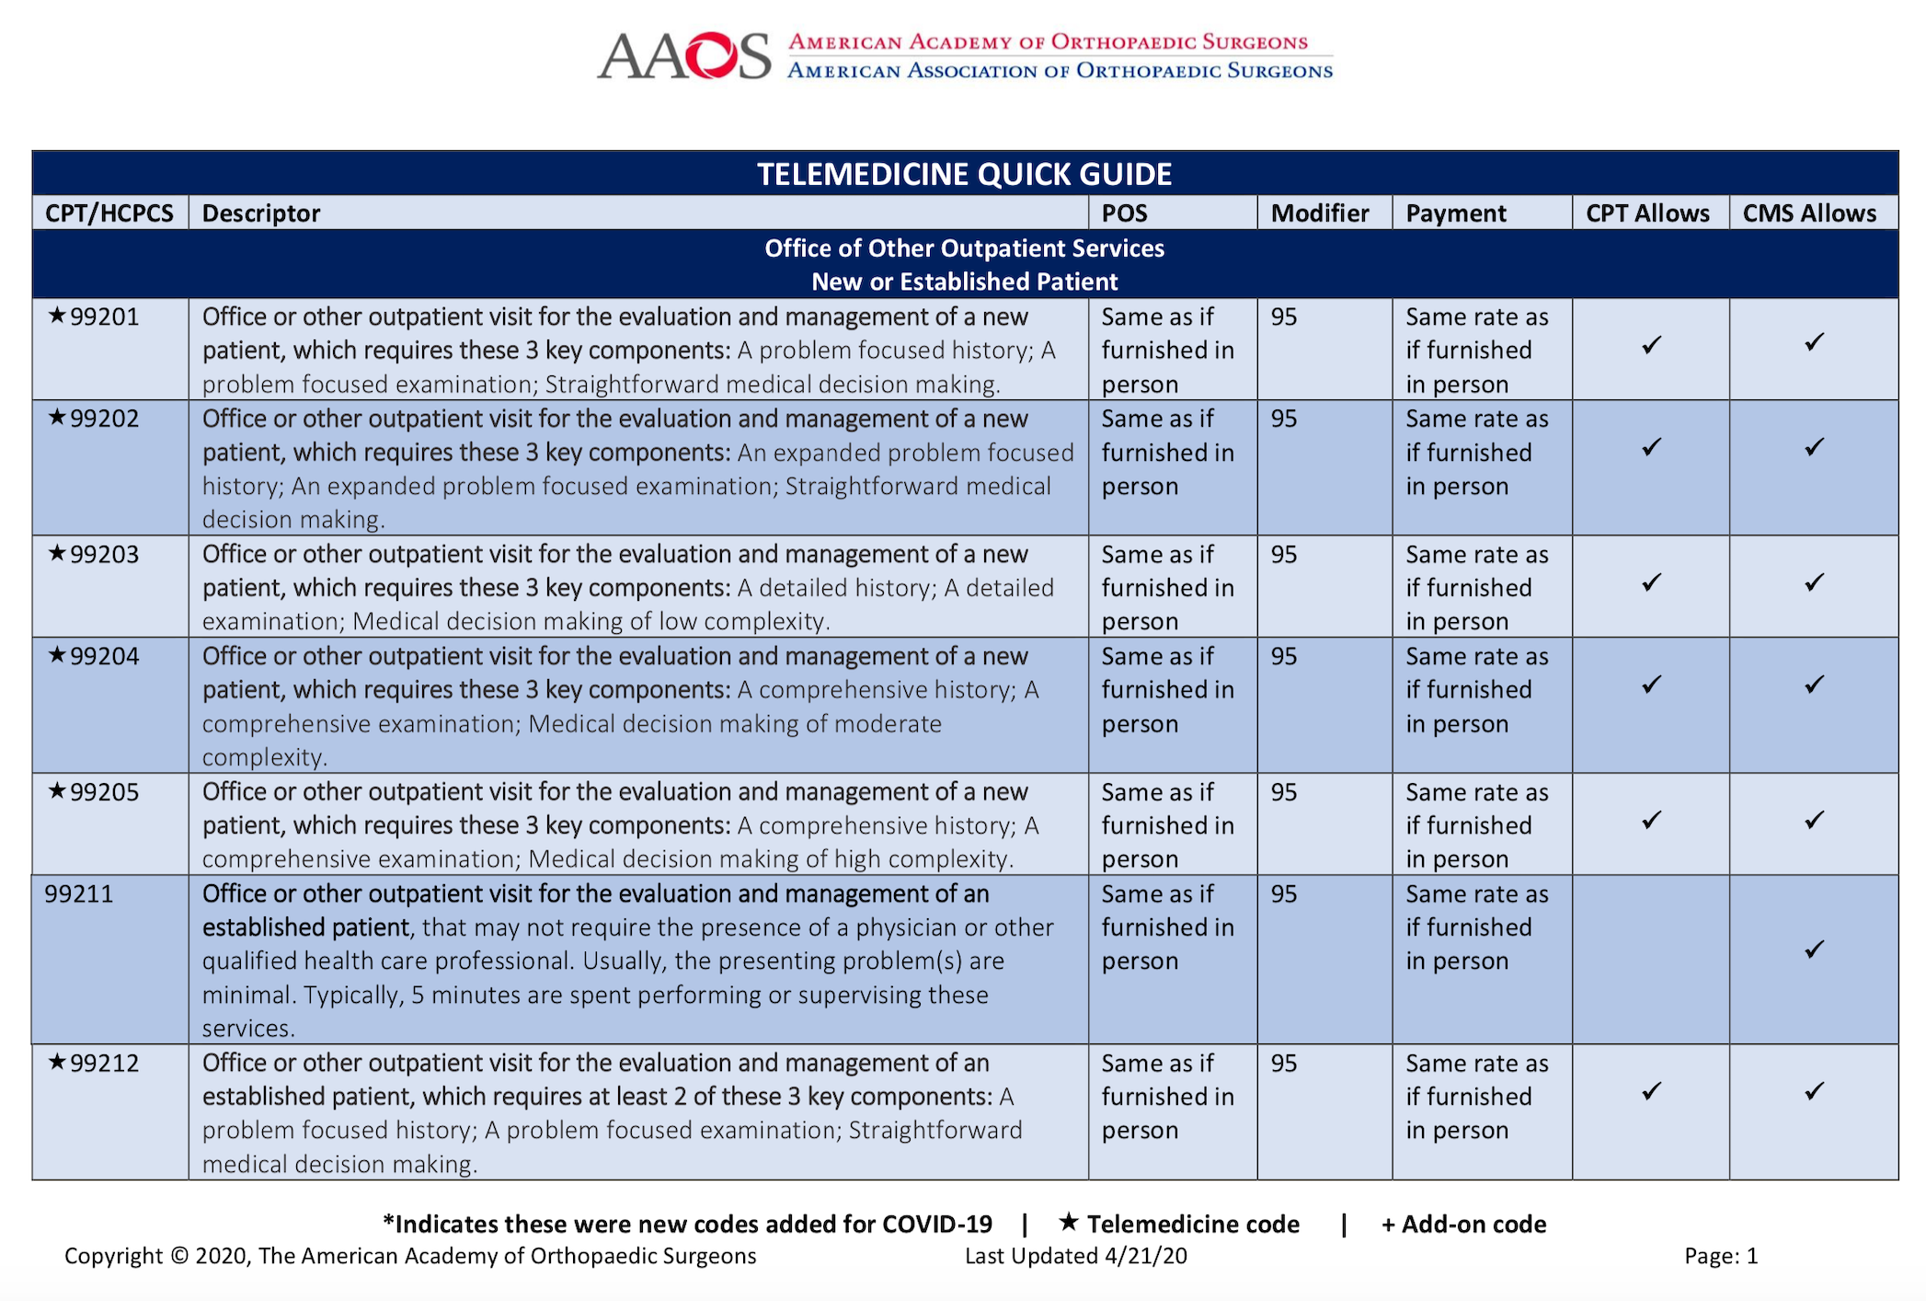
AAOS Telemedicine Quick Guide
E & M Codes
Place of Service
Modifier
Payment Rate

Slide 34
New Laboratory Codes
AMA created two additional CPT codes for patients receiving blood tests that detect COVID-19 antibodies.
86328, Immunoassay for infectious agent antibody(ies), qualitative or semiquantitative, single step method (e.g., reagent strip); severe acute respiratory syndrome coronavirus 2 (SARS-CoV-2) (Coronavirus disease [COVID-19])
86769, Antibody; severe acute respiratory syndrome coronavirus 2 (SARS-CoV-s) (Coronavirus disease [COVID-19])
The AAOS Telemedicine Coding Guide on the COVID Member Resource webpage contains these updates and more: https://www.aaos.org/globalassets/about/covid-19/aaos-coding-guide_covid19.pdf

Slide 35
New Toolkit to Help States Navigate COVID-19 Health Workforce Challenges
CMS announced the launch of a new toolkit to help states navigate COVID-19 health workforce challenges. The toolkit provides:
Information on funding flexibilities
Liability protections
Workforce training
Up-to-date best practices
Technical Resources Assistance Center and Information Exchange (TRACIE)
Information exchange of case studies & additional peer-to-peer communications
To view the COVID-10 Healthcare Workforce Toolkits visit the AAOS.org website or the HHS website: https://asprtracie.hhs.gov/Workforce-Virtual-Toolkit

Slide 36
Questions?

Slide 37
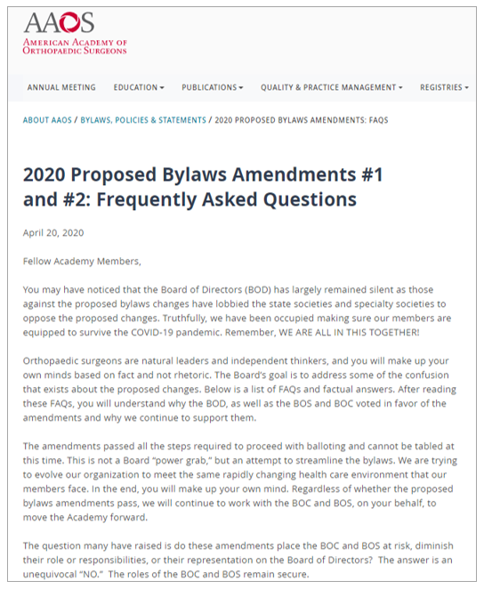
Bylaws Amendments
Get the FAQ’s
aaos.org/bylawsfaq

Slide 38
We are in this together.
To view video, visit
www.aaos.org/COVID19Leaders

